Slide 1

Solid Waste Management Plan Update
9/26/25

Slide 2
Agenda
1. Introductions
2. Solid Waste Management Plan (SWMP) Regulatory Requirements
3. Scope & Timeline
4. Draft Public Survey Review
5. Next Steps
6. Adjourn

Slide 3
Introductions
Name | Organization | Role
Greg Harper | Albemarle County | Chief of Environmental Services
Jamie Powers | Albemarle County | Climate Program Manager
Kevin McDermott | Albemarle County | Deputy Director of Planning
Michael Barnes | Albemarle County | Director of Planning
John Coles | ACPS | Sustainability Coordinator
Kristel Riddervold | Charlottesville | Director of Sustainability
Emily Irvine | Charlottesville | Climate Program Manager
Steven Hicks | Charlottesville | Director of Public Works
Jonathan Dean | Charlottesville | Public Service Manager
Ose Akinlotan | Charlottesville | Long-Range Planning Manager
Todd Fortune | Fluvanna County | Director of Planning
Dale Critzer | Fluvanna County | Director of Public Works
Jim Frydl | Greene County | Director of Planning
Stephanie Golon | Greene County | Deputy Director of Planning
Michael Taylor | Greene County | Solid Waste Manager, Director of Facility Maintenance
Phil McKalips | Rivanna Authorities | Director of Rivanna Solid Waste Authority
Courtney Cotton | UVA Recycling | Waste and Recyclable Materials Manager
Andrea Trimble | UVA Sustainability | Sustainability Director
Jessie Warren | UVA Sustainability | Office for Sustainability Associate Director

Slide 4
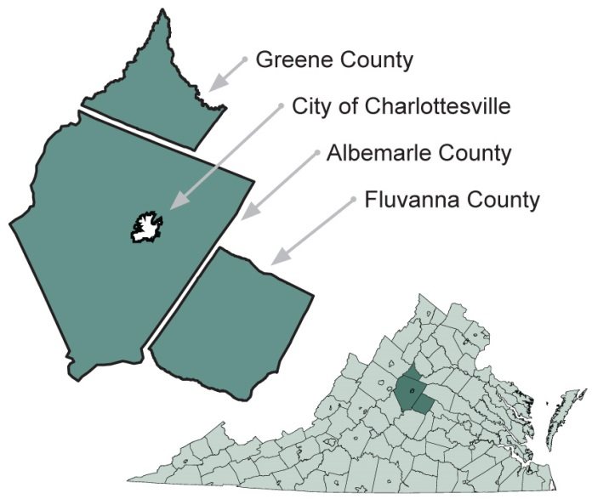
The Thomas Jefferson Solid Waste Planning Unit

Slide 5
SWMP Regulatory Requirements
VA Regulatory Requirement to update SWMP
  Adopt new 20-year plan by October 7, 2026
SWMP Requirements - outlined in 9VAC-130-120 & 9VAC-130-125
  Basic Planning Elements
    Objectives for the 20-yr planning period
    Discuss plan implementation and tracking
    Facility names, capacity, and lifespan
    Provision strategy for necessary funds and resources
    Funding and resource descriptions
    Public education and information strategy
    Consider public-private partnerships and private sector participation in execution
    Maintain a 25% recycling rate

Slide 6
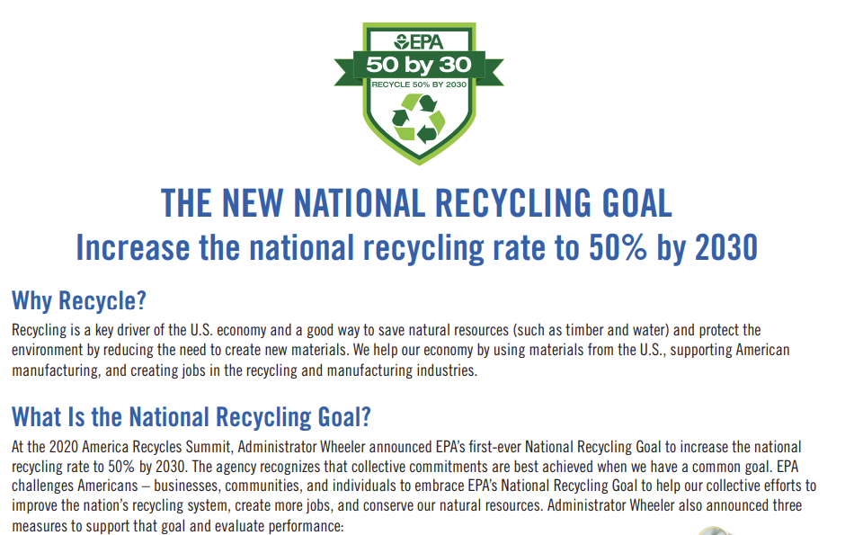
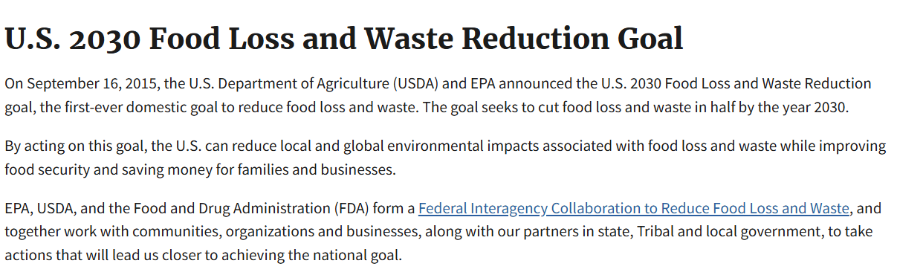
US 2030 Recycling & Food Loss and Waste Reduction Goal

Slide 7

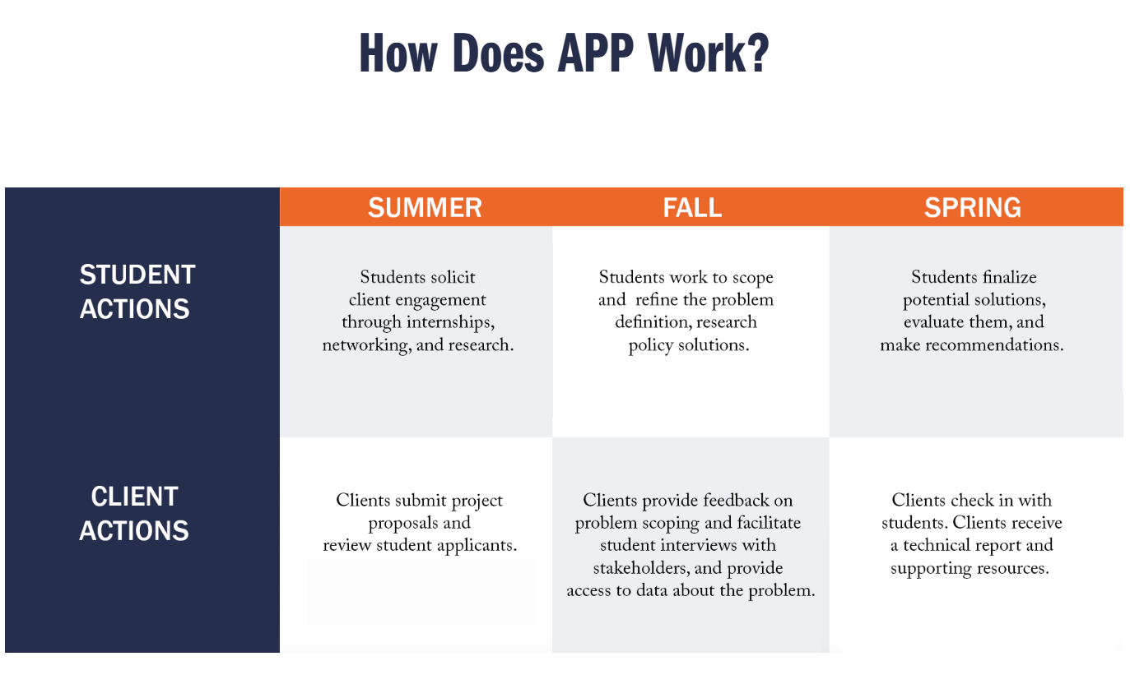
Applied Policy Project
Notes:
Current solid waste management practices contribute to a significant portion of local greenhouse gas (GHG) emissions. What are some of the most effective zero-waste and waste diversion strategies for maximizing waste diversion to reduce GHG emissions, achieve long-term cost savings for our rural jurisdictions, and prioritize equity for underserved and more rural parts of the community? What policies and regulations would need to be in place to implement said strategies, and what potential barriers to implementation are there?

Slide 8
SWMP Regulatory Requirements Continued
Data and analyses
  Population and projections
  Urban concentrations, geographic conditions, economic growth and development, reuse and recycling markets, transportation conditions, and related factors
  Estimates of solid waste generation from residential, commercial, industrial, construction and other sources
  Listing of existing and planned solid waste facilities
  All milestones in implementation of SWMP
  Solid waste reduction program descriptions
  Outreach program descriptions
  Procedures for and results of waste collection evaluation
  Assessment of current & predicted needs over 20 years
Board resolution adopting the plan

Slide 9
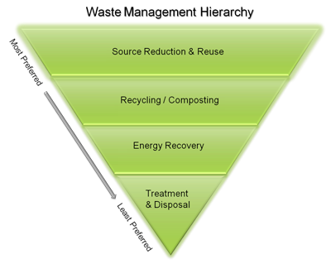
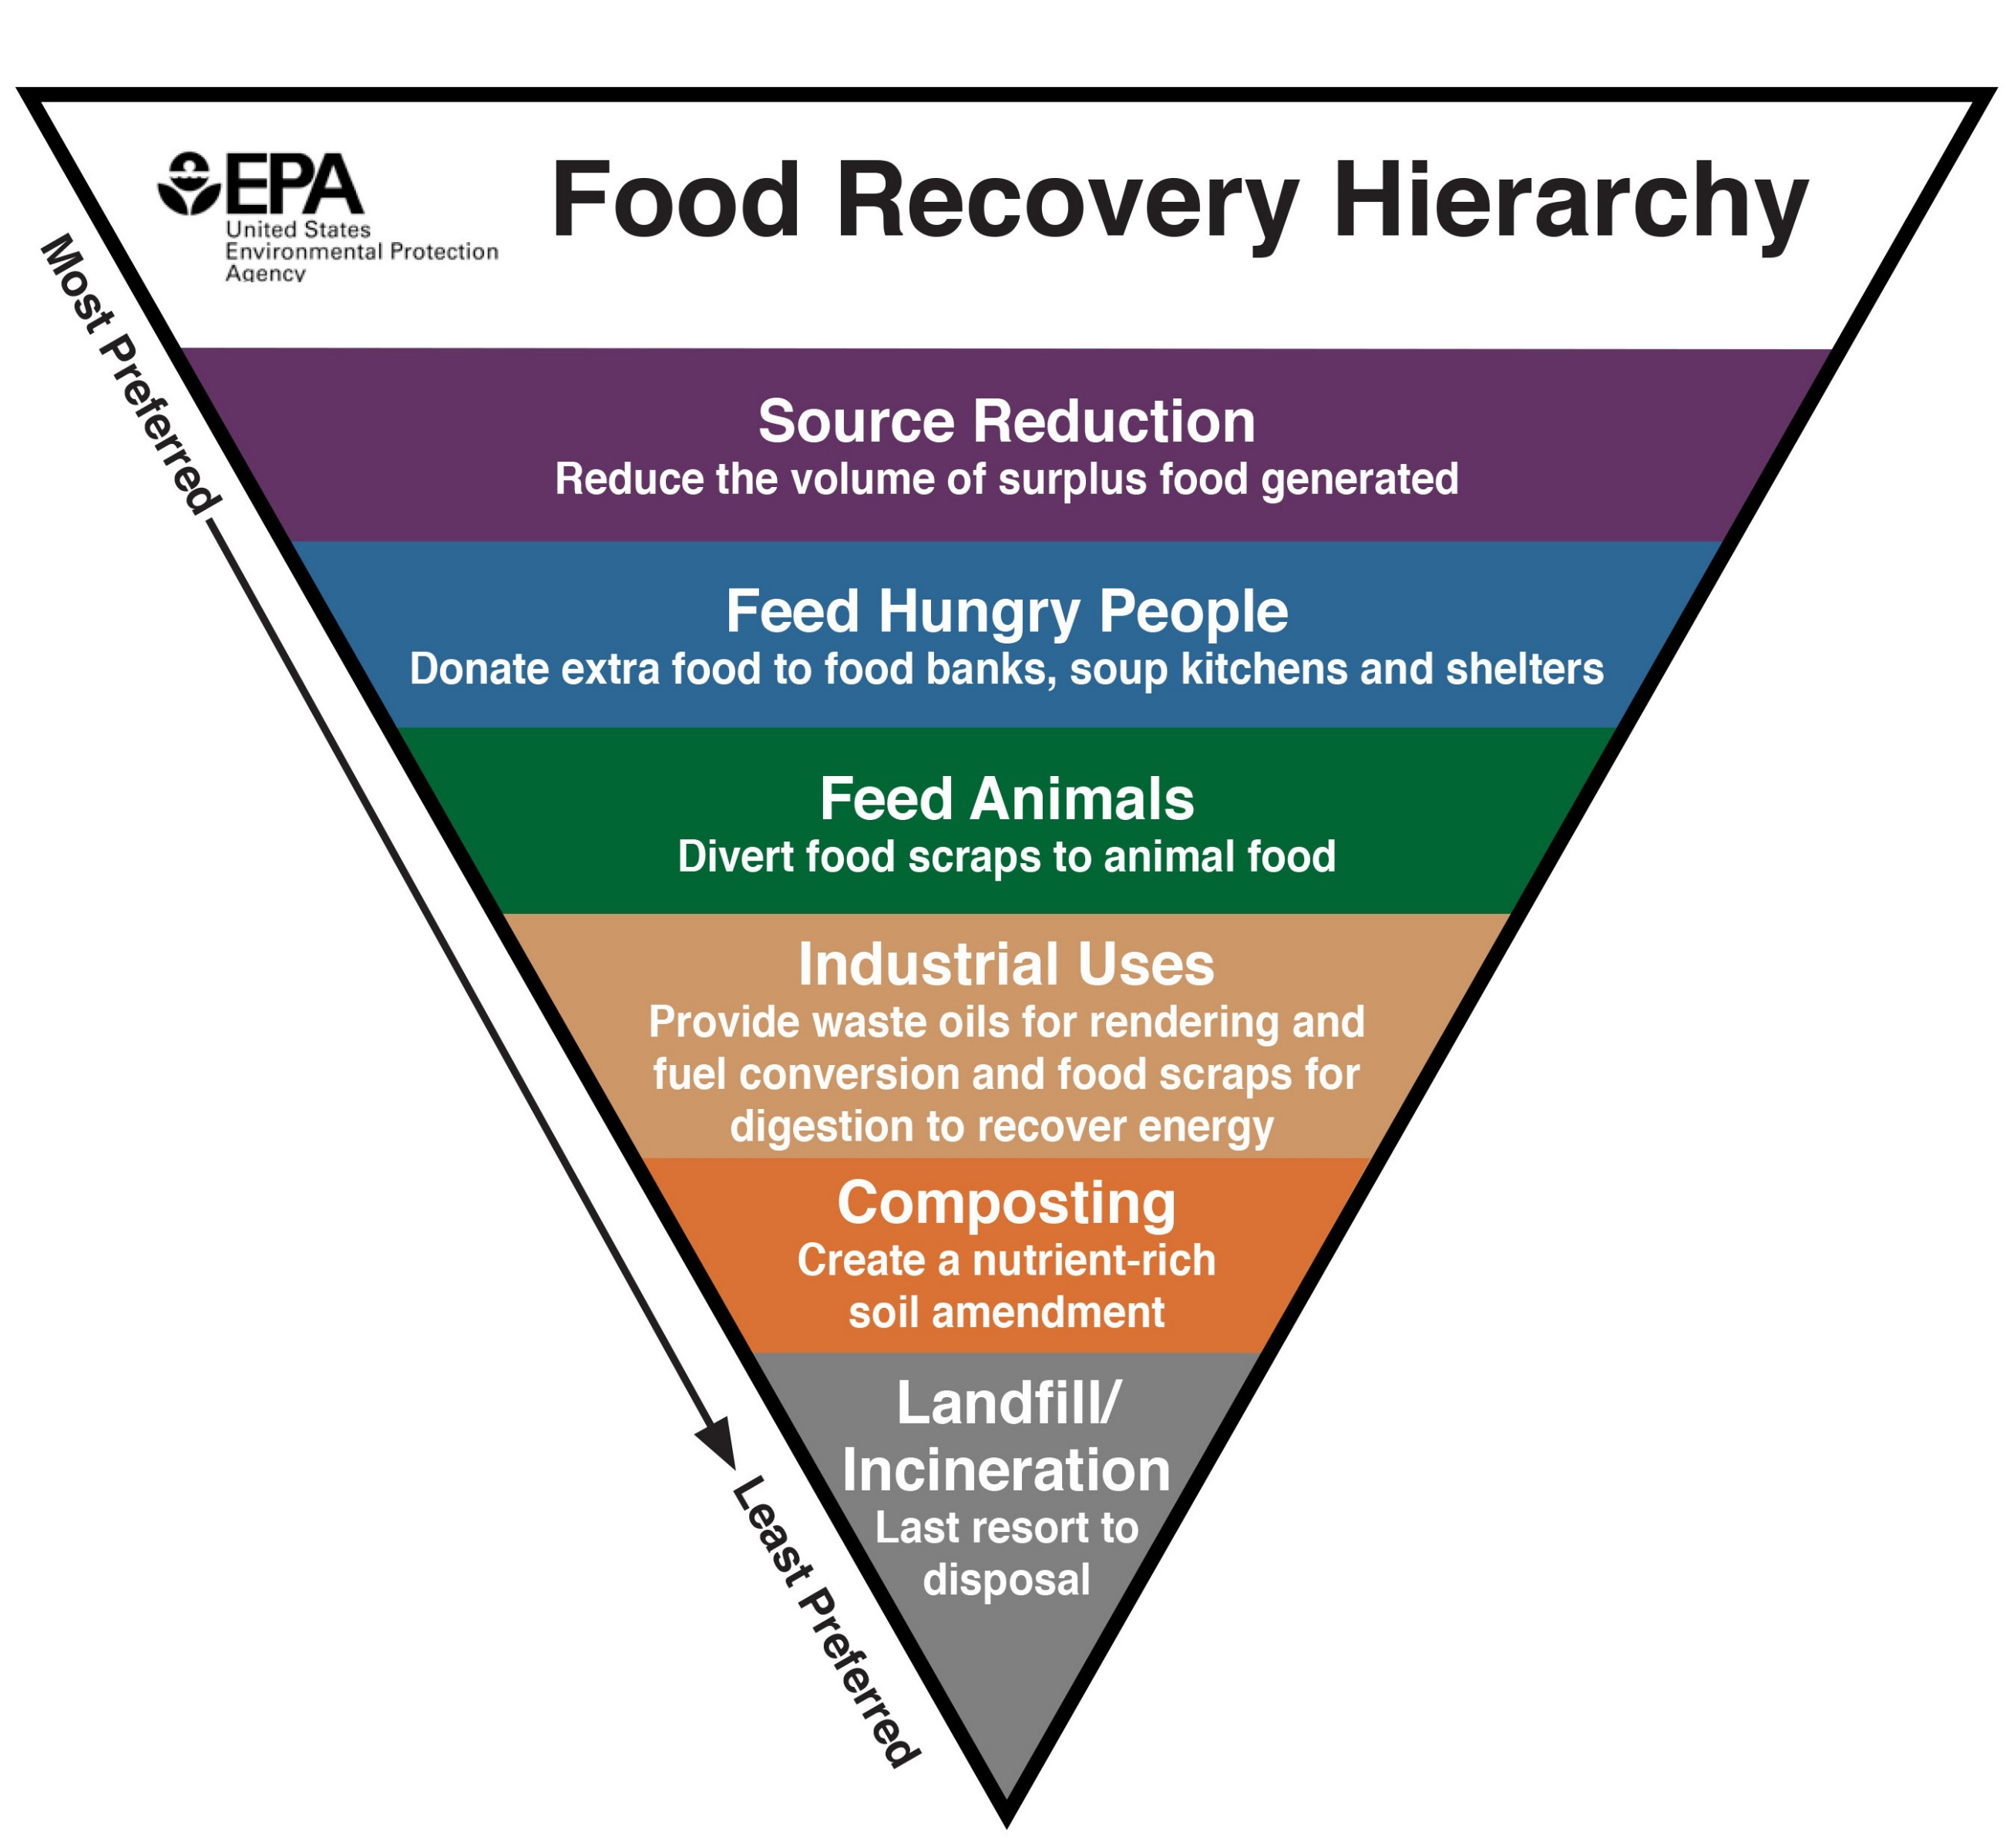
Waste Management Hierarchy
Notes:
Emphasize planning requirement from code section 9VAC20-130-120. Planning requirements: A discussion as to how the plan will be implemented and tracked, consisting of an integrated waste management strategy to support and promote the hierarchy set forth at 9VAC20-130-30; and giving preference to alternatives in the following order of priority: source reduction, reuse, recycling, resource recovery, incineration, and landfilling;

Slide 10
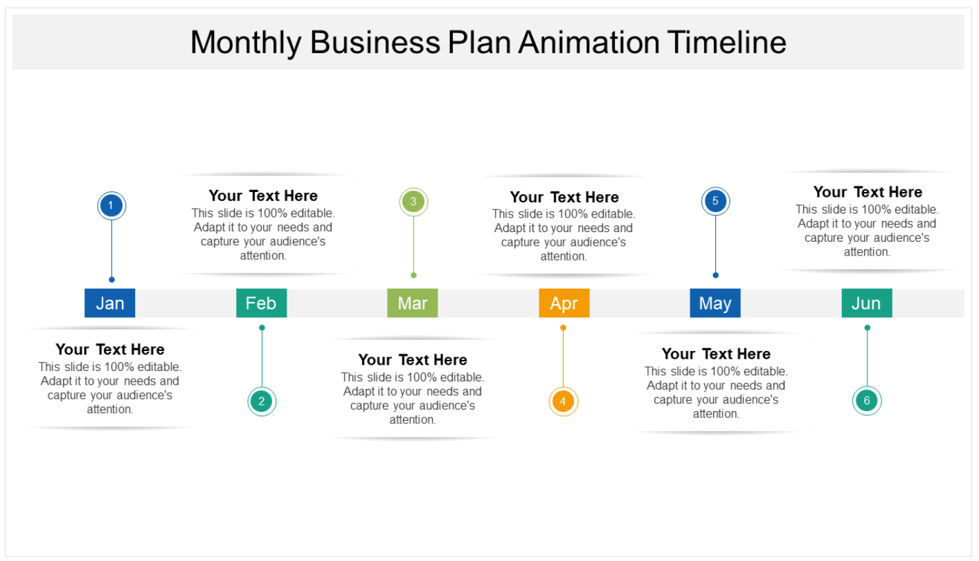
Planning Schedule
Technical Advisory Committee Meetings
Five meetings to coordinate the update with local staff and stakeholders
2
Public Engagement
Survey, Virtual Workshop, Public Comment,
Public Hearing,
Local Presentations
4
Draft & Finalize Plan
Present to TAC,
open public comment period, incorporate feedback
6
Sep – Jul 26
Sep – Oct 25
Oct 25 – Sep 26
Dec – Feb 26
Mar - Jul
Sep - Oct
1
Data Collection
& Analysis
Current & future waste generation projections
3
Implementation Planning
Determine goals, objectives, and implementation schedule
5
Adoption
Public hearing, present to TJPDC, localities, and submit to DEQ

Slide 11
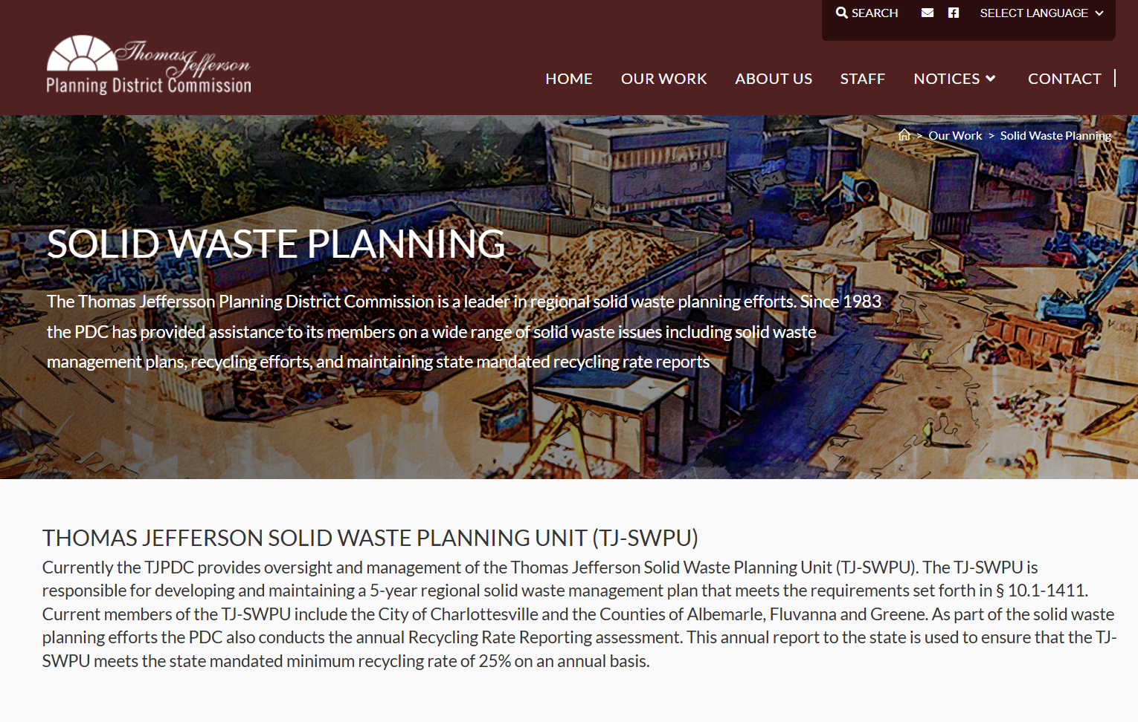
Planning Webpage
Link: https://tjpdc.org/our-work/solid-waste/
Overview
TAC Members
Meeting Materials
Past Plan Archive and Other Resources

Slide 12
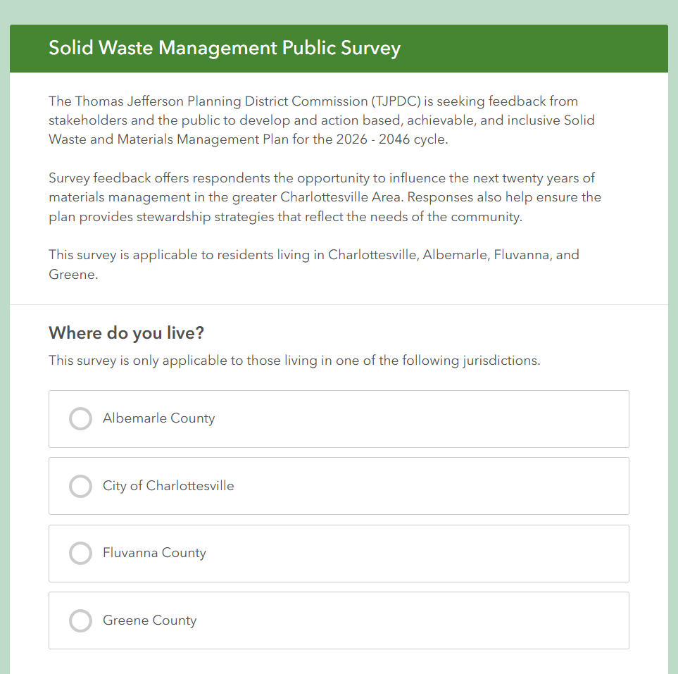
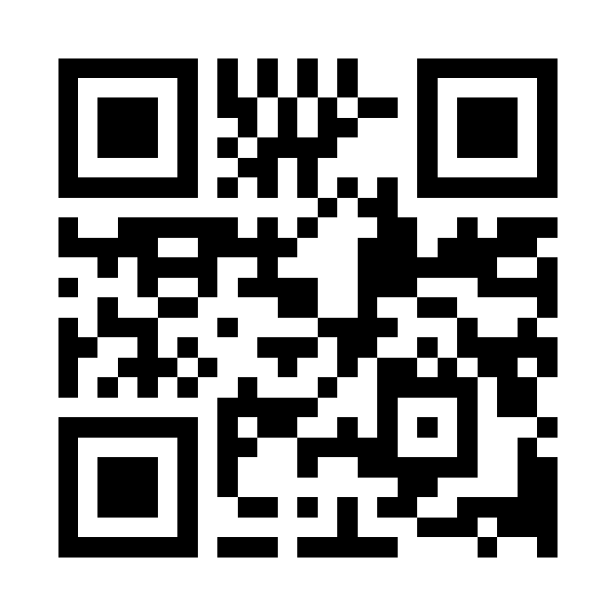
Review Draft Public Survey
https://arcg.is/0j94fb1
Share feedback by October 10th

Slide 13
Next Steps
Homework
  Take & Review Public Survey by October 10th
  Look at VA’s Planning Requirements
  Review the current Solid Waste Management Plan
November Meeting
  Potential Recurring Dates
    2nd Thursday at 10:30 (November 13)
    3rd Wednesday at 10:30 (November 19)

Slide 14

Questions?
Contact Information
Isabella O’Brien, Regional Planner 2
iobrien@tjpdc.org
434-422-4824

